Slide 1
Linear Search & Sorting Algorithms
Lab No.2
ENGR. AYESHA KHAN

Slide 2
Agenda
Linear Search
Bubble sort
Selection sort
Insertion sort
Lab Tasks

Slide 3
Linear Search

Slide 4
Linear Search
Linear search or sequential search is a method for finding a target value within a list. It sequentially checks each element of the list for the target value until a match is found or until all the elements have been searched.
In this type of search, a sequential search is made over all items one by one. Every item is checked and if a match is found then that particular item is returned, otherwise the search continues till the end of the data collection.

Slide 5
ALGORITHM
public static int LinearSearch(int[] Arr, int item)
{
int index = -1;
for (int i = 0; i<Arr.Length; i++)
{
if (Arr[i] == item)
{
index = i;
break;
}
}
return index;
}

Slide 6
Bubble Sort

Slide 7
Bubble Sort
Bubble sort, also referred to as sinking sort, is a simple sorting algorithm that works by repeatedly stepping through the list to be sorted.
Comparing each pair of adjacent items and swapping them if they are in the wrong order.
The pass through the list is repeated until no swaps are needed, which indicates that the list is sorted.
The algorithm gets its name from the way smaller elements "bubble" to the top of the list. Because it only uses comparisons to operate on elements, it is a comparison sort.
Although the algorithm is simple, most of the other sorting algorithms are more efficient for large lists.

Slide 8
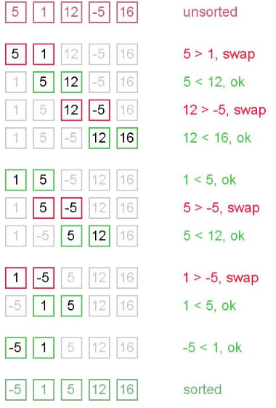
Bubble Sort
int n = array.length;
int k;
for (int m = n; m >= 0; m--) {
for (int i = 0; i < n - 1; i++) {
k = i + 1;
if (array[i] > array[k]) {
int temp;
temp = array[i];
array[i] = array[k];
array[k] = temp;
}
}
}

Slide 9
Selection Sort

Slide 10
Selection Sort
The selection sort is a combination of searching and sorting.
During each pass, the unsorted element with the smallest (or largest) value is moved to its proper position in the array.
The number of times the sort passes through the array is one less than the number of items in the array.
In the selection sort, the inner loop finds the next smallest (or largest) value and the outer loop places that value into its proper location.

Slide 11

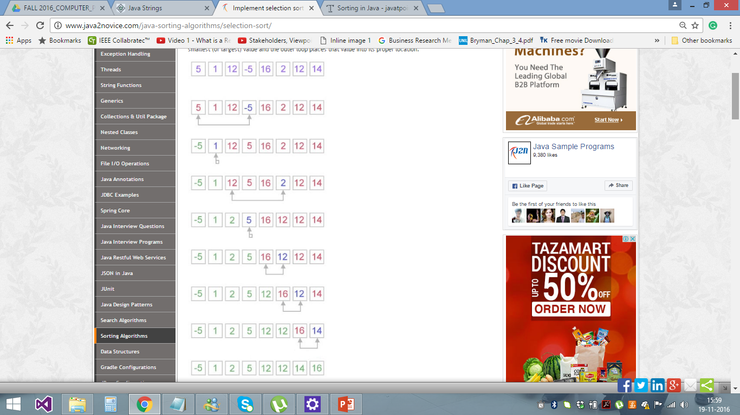
Selection Sort
int temp, smallest;
for (int i = 0; i < n - 1; i++) {
smallest = i;
for (int j = i + 1; j < n; j++) {
if (arr[j] < arr[smallest]) {
smallest = j;
}
}
temp = arr[smallest];
arr[smallest] = arr[i];
arr[i] = temp;
}

Slide 12
Insertion Sort

Slide 13
Insertion Sort
Insertion sort is a simple sorting algorithm, it builds the final sorted array one item at a time. It is much less efficient on large lists than other sort algorithms.
Insertion sort iterates through the list by consuming one input element at each repetition, and growing a sorted output list.
On a repetition, insertion sort removes one element from the input data, finds the location it belongs within the sorted list, and inserts it there. It repeats until no input elements remain.

Slide 14
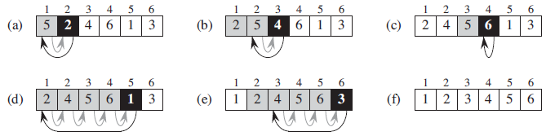
Insertion Sort

Slide 15
Insertion Sort
for (int i = 0; i < inputArray.Length - 1; i++)
{
for (int j = i + 1; j > 0; j--)
{
if (inputArray[j - 1] > inputArray[j])
{
int temp = inputArray[j - 1];
inputArray[j - 1] = inputArray[j];
inputArray[j] = temp;
}
}

Slide 16
Lab Tasks (You have to take inputs from the user to complete the array data)
Which type of sorting you want to apply? Create a menu having the following options:
Bubble Sort Method
Selection Sort Method
Insertion Sort Method
Implement using methods.
Implement Selection sort and print string array data in descending order.
A Detox chemical Industry has a list of chemicals along with their concentration and Volume. Your task is to list down the name of chemicals in descending order based on their Volume. In order to fulfil the task you have to select any of the sorting method taught in todays lab with proper reasoning of usage of that algorithm.

Slide 17
Lab Tasks (You have to take inputs from the user to complete the array data)
4. You have to write a program which take input from the user and place the value on correct location in ascending order.
5. Write a program which take N numbers of grocery items from user along with their price. Your main task is to display the items in sorted format. Then allow user to search for any of the item from that list by using name of the item.

